Slide 1
SSCC++ Inspection Robot
Design and concept of a robotic demonstration for SSCC++ RFID technique
Author: Jian Zhang
January 21^{st,} 2026

Slide 2
Goal and Background
A mobile robot capable of interpreting SSCC++-encoded RFID data, demonstrating the advantages of the SSCC++ protocol at the GS1 Connect 2026 Conference.
A robot can proactively read SSCC++ RFID data
Validate the data from tag to action properly, for example to search the child tags if they all present.
Show the results

Slide 3


Tentative Scenario
RFID enabled robot read SSCC++ encoded RFID tags
Interpret the SSCC and query information by reading EPC
Show SSCC query results
Additional actions by query results if applied.
RFID enabled Robots

Slide 4
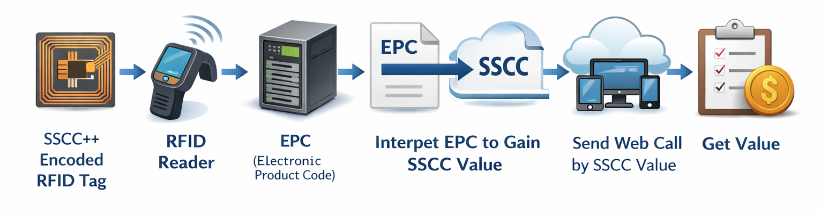
Typical Architecture of SSCC++ interpretation
encoded URL
The typical data flow of interpret SSCC++ is SSCC++encoded tags → RFID reader → EPC → interpret EPC to gain SSCC value → send Web call by SSCC value encoded URL → Get value:
SSCC++ encoded tags: Physical RFID tags encoded with SSCC++.​
RFID reader: Captures EPC from the tags.​
EPC interpretation: Convert EPC to SSCC value.​
Web call: Construct URL with encoded SSCC.​
Response: Retrieve associated data to drive robot actions.​

